Slide 1
Science of Living System
BS20001
Ritobrata Goswami
School of Bioscience
Email: ritobrata.goswami@iitkgp.ac.in
Tel: 03222-260518

Slide 2
DNA Replication: An Overview
Notes:
DNA replication is the process in which new copy of DNA is produced from parent DNA. When two strand of DNA are separated, each strand act as template for the formation of new strand. This process is called DNA replication.
Life is dependent on the information stored on the DNA. Without replication of the DNA the information would not be passed on and life would cease to exist.

Slide 3
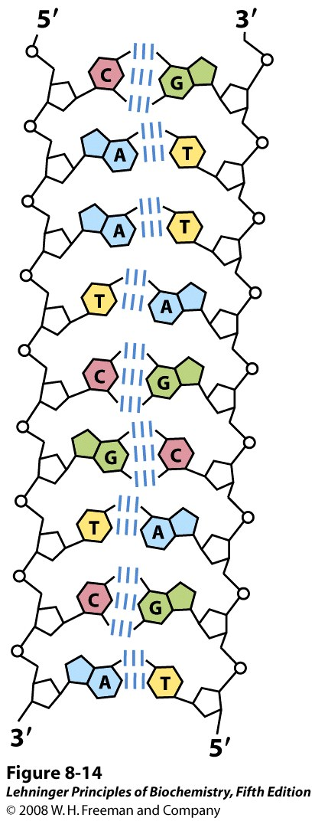
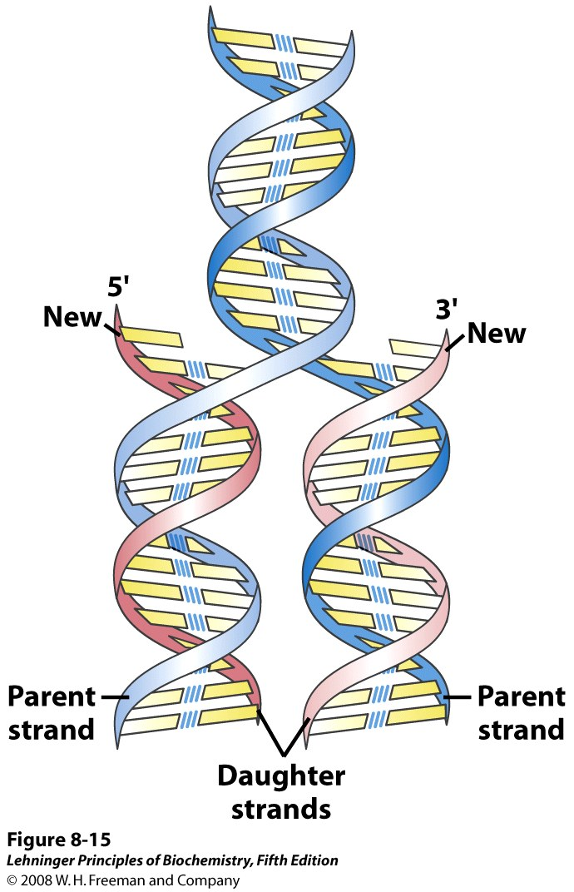
Semiconservative Replication of DNA as suggested by Watson and Crick
Notes:
Replication of DNA as suggested by Watson and Crick. The pre-existing or "parent" strands become separated, and each is the template for biosynthesis of a complementary "daughter" strand (in pink).

Slide 4
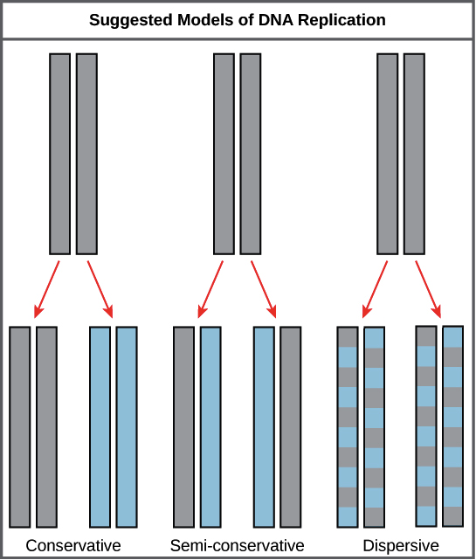
Notes:
Conservative replication. DNA replication results in one molecule that consists of both original DNA strands (identical to the original DNA molecule) and another molecule that consists of two new strands (with exactly the same sequences as the original molecule).
Semi-conservative replication. The two strands of DNA unwind from each other, and each acts as a template for synthesis of a new, complementary strand. This results in two DNA molecules with one original strand and one new strand.
Dispersive replication. DNA replication results in two DNA molecules that are mixtures, or “hybrids,” of parental and daughter DNA. In this model, each individual strand is a patchwork of original and new DNA.

Slide 5
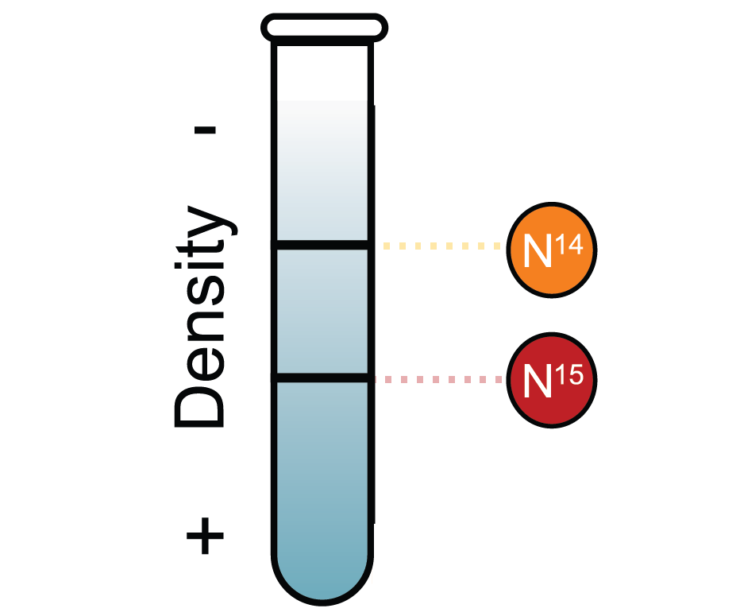
The Meselson-Stahl Experiment (1958)
Notes:
Meselson and Stahl conducted their experiments on DNA replication using E. coli bacteria as a model system.
They began by growing E. coli in medium, or nutrient broth, containing a "heavy" isotope of nitrogen, 15N. When grown on medium containing heavy 15N, the bacteria took up the nitrogen and used it to synthesize new biological molecules, including DNA.
After many generations growing in the 15N medium, the nitrogenous bases of the bacteria's DNA were all labeled with heavy 15N. Then, the bacteria were switched to medium containing a "light“ 14N isotope and allowed to grow for several generations. DNA made after the switch would have to be made up of 14N, as this would have been the only nitrogen available for DNA synthesis.
Meselson and Stahl knew how often E. coli cells divided, so they were able to collect small samples in each generation and extract and purify the DNA. They then measured the density of the DNA using density gradient centrifugation.
This method separates molecules such as DNA into bands by spinning them at high speeds in the presence of another molecule, such as cesium chloride, that forms a density gradient from the top to the bottom of the spinning tube. Density gradient centrifugation allows very small differences—like those between 15N and 14N labeled DNA—to be detected.

Slide 6
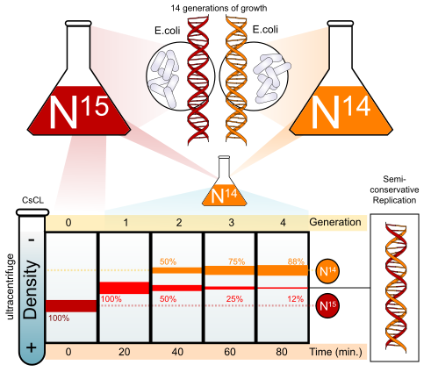
The Meselson-Stahl Experiment (1958)
Notes:
Results of the experiment
When DNA from the first four generations of E. coli was analyzed, it produced the pattern of bands shown in the figure below:
Generation 0
DNA isolated from cells at the start of the experiment (“generation 0,” just before the switch to 14N medium) produced a single band after centrifugation. Makes sense because the DNA should have contained only heavy 15N at that time.
Generation 1
DNA isolated after one generation also produced a single band when centrifuged. However, this band was higher, intermediate in density between the heavy 15N DNA and the light 14N DNA.
The intermediate band told Meselson and Stahl that the DNA molecules made in the first round of replication was a hybrid of light and heavy DNA. This result fit with the dispersive and semi-conservative models, but not with the conservative model.
The conservative model would have predicted two distinct bands in this generation (a band for the heavy original molecule and a band for the light, newly made molecule).
Generation 2
Information from the second generation let Meselson and Stahl determine which of the remaining models (semi-conservative or dispersive) was actually correct.
When second-generation DNA was centrifuged, it produced two bands. One was in the same position as the intermediate band from the first generation, while the second was higher (appeared to be labeled only with 14N).

Slide 7
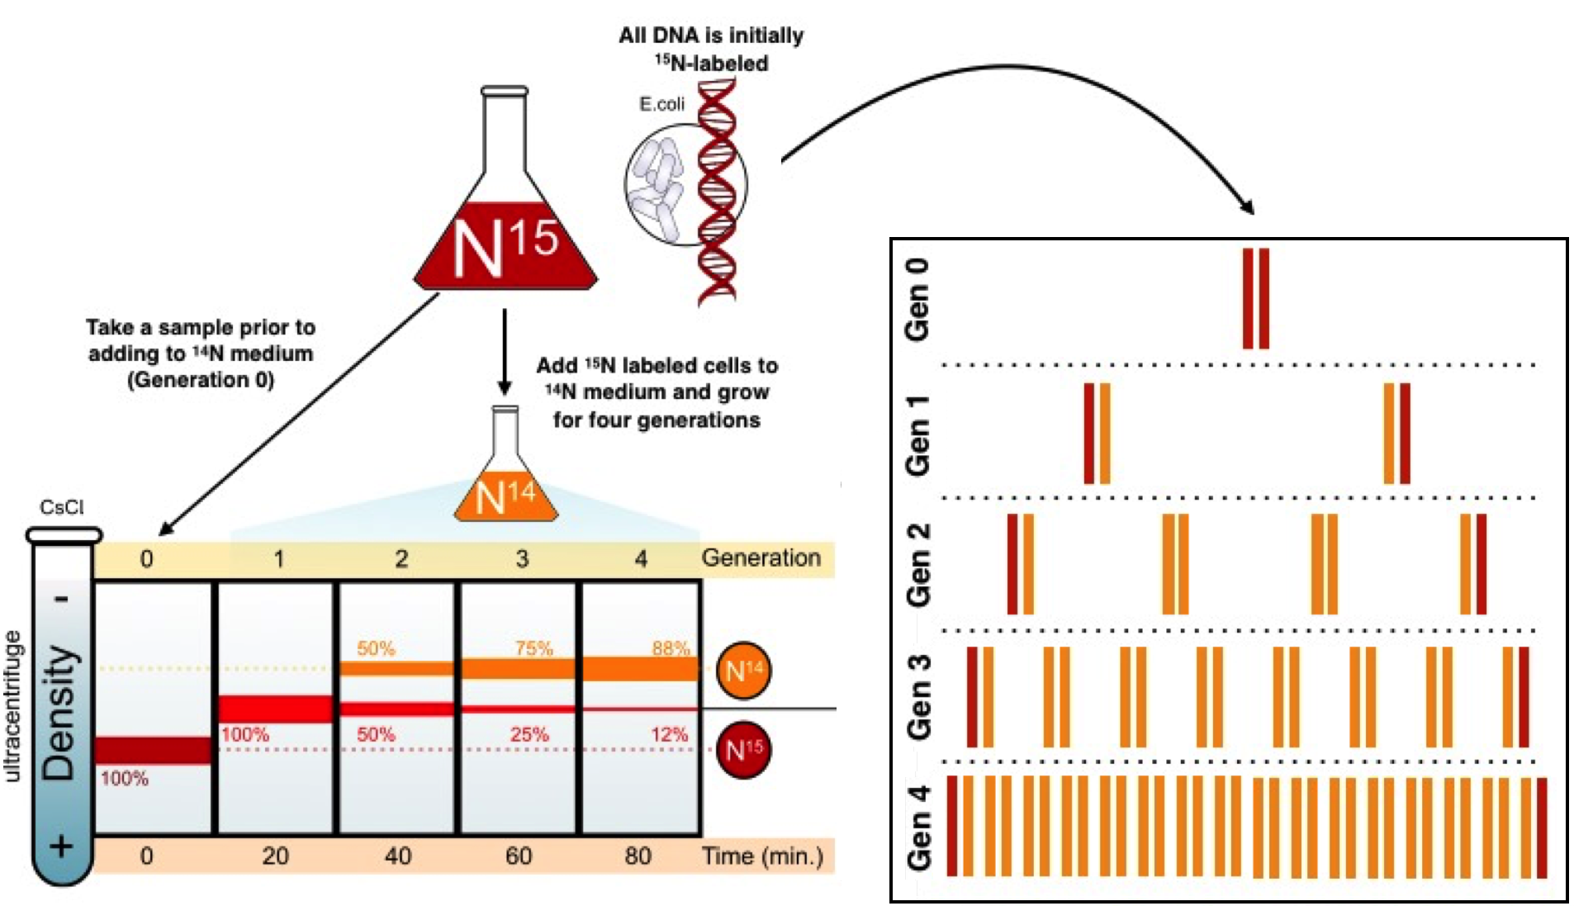
The Meselson-Stahl Experiment Supports Semiconservative Replication
Notes:
In dispersive replication, all the molecules should have bits of old and new DNA, making it impossible to get a "purely light" molecule.
Generations 3 and 4
In the semi-conservative model, each hybrid DNA molecule from the second generation would be expected to give rise to a hybrid molecule and a light molecule in the third generation, while each light DNA molecule would only yield more light molecules.
Thus, over the third and fourth generations, we'd expect the hybrid band to become progressively fainter and the light band to become progressively stronger.
As we can see in the figure, Meselson and Stahl saw just this pattern in their results, confirming a semi-conservative replication model.
Conclusion
The experiment done by Meselson and Stahl demonstrated that DNA replicated semi-conservatively, meaning that each strand in a DNA molecule serves as a template for synthesis of a new, complementary strand.

Slide 8
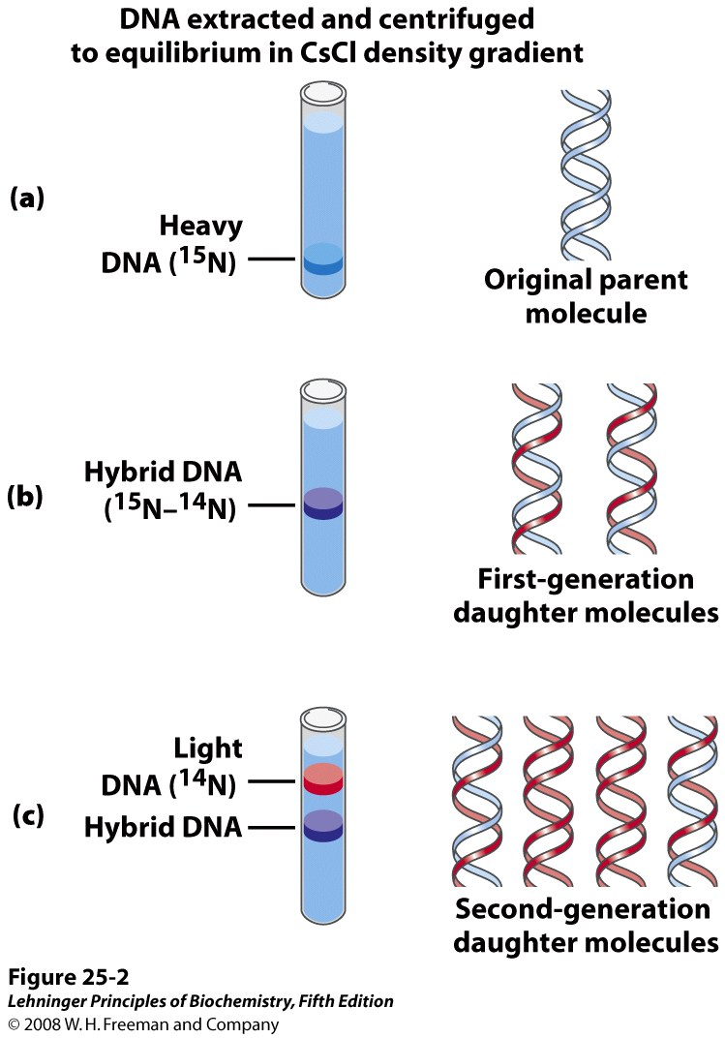
The Meselson-Stahl Experiment Supports Semiconservative Replication
Notes:
The Meselson-Stahl experiment. (a) Cells were grown for many generations in a medium containing only heavy nitrogen, ¹⁵N, so that all the nitrogen in their DNA was ¹⁵N, as shown by a single band (blue) when centrifuged in a CsCl density gradient. (b) Once the cells had been transferred to a medium containing only light nitrogen, ¹⁴N, cellular DNA isolated after one generation equilibrated at a higher position in the density gradient (purple band). (c) A second cycle of replication yielded a hybrid DNA band (purple) and another band (red), containing only [¹⁴N]DNA, confirming semiconservative replication.

Slide 9
Outline for Replication
A. Initiation
B. Priming
C. Elongation
D. Proofreading and Termination
Notes:
The replication process relies on the fact that each strand of DNA can serve as a template for duplication. DNA replication initiates at specific points, called origins, where the DNA double helix is unwound. A short segment of RNA, called a primer, is then synthesized and acts as a starting point for new DNA synthesis. The enzyme DNA polymerase next begins replicating the DNA by matching bases to the original strand. Once synthesis is complete, the RNA primers are replaced with DNA, and any gaps between newly synthesized DNA segments are sealed together with other enzymes.

Slide 10
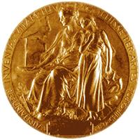
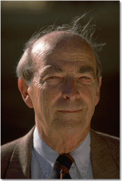
Arthur Kornberg
Nobel Prize in 1959
Worked with E. coli. Discovered the mechanisms of
DNA synthesis in 1956.
Four components are required:
dNTPs: dATP, dTTP, dGTP, dCTP
(deoxyribonucleoside 5’-triphosphates)
(sugar-base + 3 phosphates)
2. DNA template
DNA polymerase (Kornberg enzyme)
Mg²⁺ (optimizes DNA polymerase activity)
Primer
Notes:
Requirements for DNA Synthesis
There are four basic components required to initiate and propagate DNA synthesis. They are: substrates, template, primer and enzymes.
Substrates
Four deoxyribonucleotide triphosphates (dNTP's) are required for DNA synthesis. These are dATP, dGTP, dTTP and dCTP.
Ribonucleoside triphosphates (NTP's) are also required to initiate and sustain DNA synthesis. NTP's are used in the synthesis of RNA primers and ATP is used as an energy source for some of the enzymes needed to initiate and sustain DNA synthesis at the replication fork.
Template
The nucleotide that is to be incorporated into the growing DNA chain is selected by base pairing with the template strand of the DNA.
Primer
The enzyme that synthesizes DNA, DNA polymerase, can only add nucleotides to an already existing strand or primer of DNA or RNA that is base paired with the template.
Enzymes
DNA polymerase, is required for the covalent joining of the incoming nucleotide to the primer.

Slide 11
Polymerization of nucleotide triphosphates by DNA polymerase – needs free 3’OH
OH
OH
Notes:
DNA polymerase, also known as DNA pol, which adds nucleotides one-by-one to the growing DNA chain that is complementary to the template strand. The addition of nucleotides requires energy; this energy is obtained from the nucleoside triphosphates ATP, GTP, TTP and CTP. When the bond between the phosphates is “broken,” the energy released is used to form the phosphodiester bond between the incoming nucleotide and the growing chain.
In prokaryotes, three main types of polymerases are known: DNA pol I, DNA pol II, and DNA pol III. DNA pol III is the enzyme required for DNA synthesis.

Slide 12
Problem -1
DNA is double helical. Hence the two strands have to be separated from each other

Slide 13
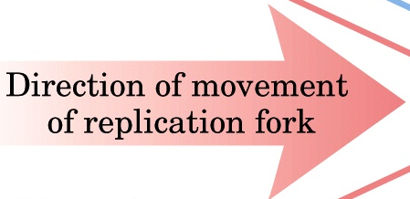
Problem - 1 : DNA unwinding
DNA is unwound by helicase, stabilized by SSB proteins; supercoiling is relaxed by Topoisomerase
5’
SSB (single strand binding) Proteins
ATP
ADP
Helicase
+
Initiator Proteins
Helicase
3’
3’
5’
5’
Topoisomerase
3’
Notes:
There are specific nucleotide sequences called origins of replication where replication begins. The origin of replication is recognized by certain proteins that bind to this site. An enzyme called helicase unwinds the DNA by breaking the hydrogen bonds between the nitrogenous base pairs. ATP hydrolysis is required for this process. As the DNA opens up, Y-shaped structures called replication forks are formed. Single-strand binding proteins coat the single strands of DNA near the replication fork to prevent the single-stranded DNA from winding back into a double helix.

Slide 14
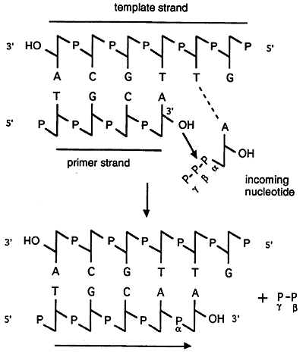
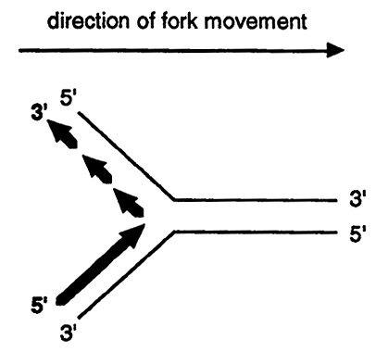
DNA synthesis: 5’ to 3’
Notes:
DNA synthesis always occurs in a 5' to 3' direction and that the incoming nucleotide first base pairs with the template and is then linked to the nucleotide on the primer.

Slide 15
Problem - 2
DNA polymerase needs a free 3’-OH of a pre-existing nucleotide to extend the chain
OH
OH
Notes:
DNA polymerase has two important restrictions: it is able to add nucleotides only in the 5′ to 3′ direction. It also requires a free 3′-OH group to which it can add nucleotides by forming a phosphodiester bond between the 3′-OH end and the 5′ phosphate of the next nucleotide. So it cannot add nucleotides if a free 3′-OH group is not available. Then how does it add the first nucleotide?
You need the help of a primer that provides the free 3′-OH end. The enzyme RNA primase synthesizes an RNA segment that is about five to ten nucleotides long; complementary to the template DNA. DNA polymerase can now extend this RNA primer, adding nucleotides one-by-one that are complementary to the template strand.

Slide 16
Problem – 2 : Free 3’ OH group required
Primase synthesizes small RNA primers,
DNA Polymerase III extends them
5’
SSB (single strand binding) Proteins
Okazaki Fragments
1
ATP
Polymerase III
2
Lagging strand
3
Helicase
+
Initiator Proteins
3’
5’
Leading strand
Polymerase III
5’ → 3’
RNA Primer
primase
3’
Notes:
Helicase unwinds the double helix in advance of the replication fork. DNA polymerase III can only extend a pre-existing strand. Hence, a short sequence (RNA primer) is provided by RNA polymerase, which is extended by the DNA polymerase III. Later on, this RNA primer is replaced by polymerase I, which put DNA. Finally, ligase joins the fragments.
DNA polymerase III can extend a strand only in the 5’ to 3’ direction. Hence, the lagging strand is synthesized discontinuously as more and more DNA is unwound by the helicase. The fragments on the lagging strand are called Okazaki fragments.

Slide 17
Problem -3 : RNA primers need to be removed
RNA primers are replaced with DNA by DNA Polymerase I, which has both RNaseH and DNA Polymerase activity. The gaps are sealed by Ligase
5’
SSB (single strand binding) Proteins
Okazaki Fragments
1
ATP
Polymerase III
2
Lagging strand
Helicase
+
Initiator Proteins
3
3’
5’
Leading strand
RNA primer replaced by polymerase I (inherent RNaseH)
Polymerase III
5’ → 3’
RNA Primer
Gaps are sealed by ligase
3’
Notes:
DNA unwinds at the origin of replication.
Helicase opens up the DNA-forming replication forks.
Single-strand binding proteins coat the DNA around the replication fork to prevent rewinding of the DNA.
Topoisomerase binds at the region ahead of the replication fork to prevent supercoiling.
Primase synthesizes RNA primers complementary to the DNA strand.
DNA polymerase III starts adding nucleotides to the 3′-OH end of the primer.
Elongation of both the lagging and the leading strand continues.
RNA primers are removed by exonuclease activity.
Gaps are filled by DNA pol I by adding dNTPs.
The gap between the two DNA fragments is sealed by DNA ligase, which helps in the formation of phosphodiester bonds.

Slide 18
DNA Replication: Summary
DNA is unwound by initiator protein + helicase
Single stranded DNA is stabilized by single stranded DNA binding proteins (SSB)
Supercoiling is relaxed by Topoisomerase
Small RNA primers are added by Primase (RNA polymerase)
DNA Polymerase III extends from 3’ ends of primer sequences
DNA Polymerase can only extend from pre-existing 3’OH group
Hence synthesis is always from 5’-3’ direction
It needs DNA template, dNTPs and Mg²⁺ ions
Replication is continuous in leading strand and discontinuous in lagging strands. Small newly synthesized DNA fragments in lagging strand are called Okazaki fragments
RNA primers are replaced with DNA by DNA Polymerase I, which has both RNaseH and DNA Polymerase activity
The gaps are sealed by Ligase
Notes:
1. Initiation
Replication starts at a specific point of DNA called origin of replication.
Each uncoiled parental DNA strand acts as template DNA strand for the synthesis of new complementary strands.
When two strands unwind and separate incompletely, they form Y-shape where active synthesis occurs. This region is called replication fork.
Each separated strands are stabilized by single stranded binding protein.
As the two strands are separated, supercoiling occurs which is removed by DNA topoisomerase.
Initiation of replication requires RNA primer, which is a small strand of RNA, synthesized by primase.
2. Chain Elongation
Chain elongation proceeds from the initiation site by the addition of deoxyribonucleotides at 3’-OH end of the primer by DNA polymerase III.
DNA Polymerase III forms continuous strand of DNA on 3’→5’ template. The continuous strand of DNA is called leading strand. Since the direction of movement of replication fork and direction of leading strand synthesis are same, leading strand is synthesized continuously after its initiation.
In other template strand 5’→3’, there is discontinuous formation of DNA and thus more RNA primer are required for the formation of whole strand. Due to discontinuous formation, smaller fragments are formed, which are called Okazaki fragments. DNA ligase joins these Okazaki fragments to form complete lagging strands. Since the direction of movement of replication fork is opposite to direction of lagging strand synthesis, it cannot be synthesized continuously.
After completion of chain elongation RNA primer is removed by exonuclease activity (RNaseH) of DNA polymerase I and the gap is filled with complementary bases.
3. Termination
Replication must be terminated to produce two daughter DNA molecules.

Slide 19
Laboratory methods for nucleic acid analysis

Slide 20
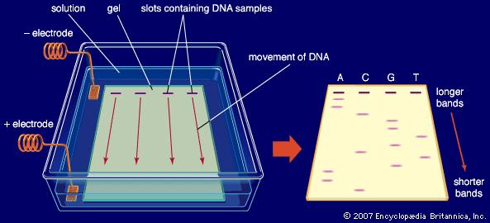
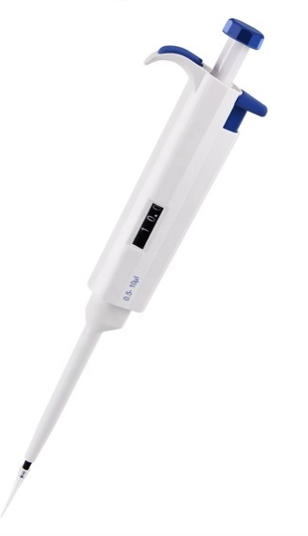
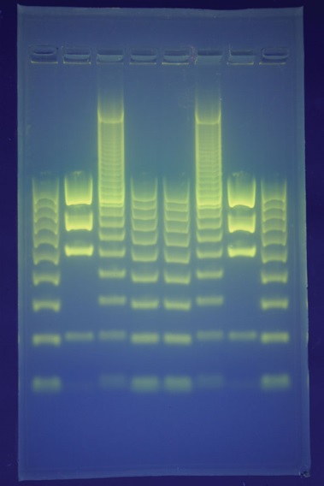
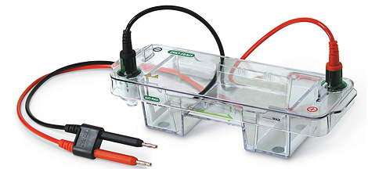
DNA Gel Electrophoresis
Notes:
Gel electrophoresis is a laboratory method used to separate mixtures of DNA, RNA, or proteins according to molecular size. Charged molecules move through a gel when an electric current is passed across it.
An electric current is applied across the gel so that one end of the gel has a positive charge and the other end has a negative charge.
The movement of charged molecules is called migration. Molecules migrate towards the opposite charge. (opposites attract!).
Smaller molecules migrate through the gel more quickly and therefore travel further than larger fragments that migrate more slowly and therefore will travel a shorter distance. As a result the molecules are separated by size.
The use of dyes, fluorescent tags helps the DNA on the gel to be seen after they have been separated. They will appear as bands on the gel.
A DNA marker with fragments of known lengths is usually run through the gel at the same time as the samples. By comparing the bands of the DNA samples with those from the DNA marker, you can work out the approximate length of the DNA fragments in the samples.

Slide 21
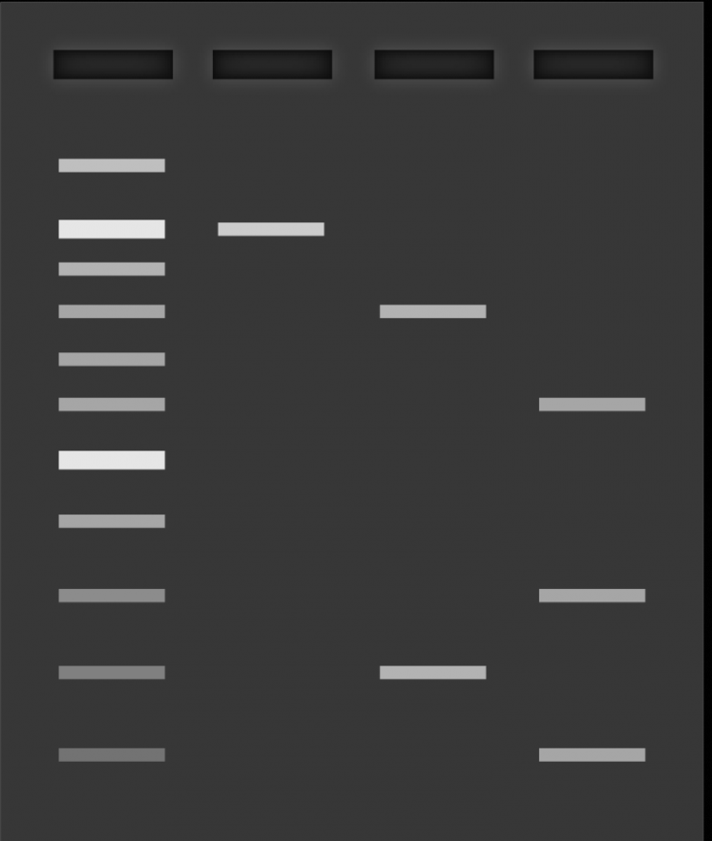
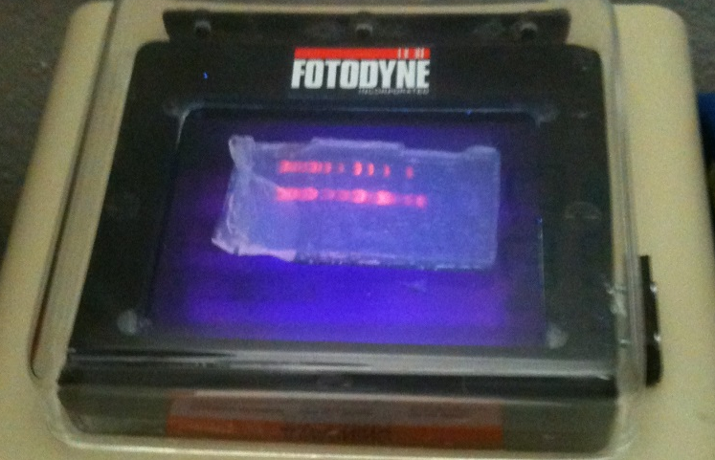
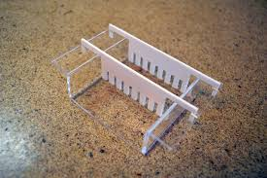
DNA Gel Electrophoresis
Agarose gel is used to analyze a mixture of DNA.
DNA is negatively charged and hence migrates towards the positive terminal in the applied electric field gradient.
Different DNA molecules separate according to mass.
Smaller molecules migrate faster.
DNA is visualized in the gel by staining with ethidium bromide, which fluoresces under UV light.
UV light at 302 nm or 365 nm wavelengths are used.
Notes:
Agarose gels are typically used to visualise fragments of DNA. The concentration of agarose used to make the gel depends on the size of the DNA fragments you are working with.
The higher the agarose concentration, the denser the matrix and vice versa. Smaller fragments of DNA are separated on higher concentrations of agarose whilst larger molecules require a lower concentration of agarose.
To make a gel, agarose powder is mixed with an electrophoresis buffer and heated to a high temperature until all of the agarose powder has melted.
The molten gel is then poured into a gel casting tray and a “comb” is placed at one end to make wells for the sample to be pipetted into.
Once the gel has cooled and solidified the comb is removed.
The gel is then placed into an electrophoresis tank and electrophoresis buffer is poured into the tank until the surface of the gel is covered. The buffer conducts the electric current.
A dye is added to the sample of DNA prior to electrophoresis to increase the viscosity of the sample which will prevent it from floating out of the wells and so that the migration of the sample through the gel can be seen.
A DNA marker (also known as a DNA ladder) is loaded into the first well of the gel. The fragments in the marker are of a known length so can be used to help approximate the size of the fragments in the samples.
The prepared DNA samples are then pipetted into the remaining wells of the gel.
Separating the fragments
The electrical current is then turned on so that the negatively charged DNA moves through the gel towards the positive side of the gel.
Shorter lengths of DNA move faster than longer lengths so move further in the time the current is run.
The distance the DNA has migrated in the gel can be judged visually by monitoring the migration of the loading buffer dye.
To visualise the DNA, the gel is stained with a fluorescent dye that binds to the DNA, and is placed on an ultraviolet transilluminator which will show up the stained DNA as bright bands.
If the gel has run correctly the banding pattern of the DNA marker/size standard will be visible.
It is then possible to judge the size of the DNA in your sample by imagining a horizontal line running across from the bands of the DNA marker. You can then estimate the size of the DNA in the sample by matching them against the closest band in the marker.

Slide 22
Polymerase Chain Reaction (PCR) and Its Applications

Slide 23
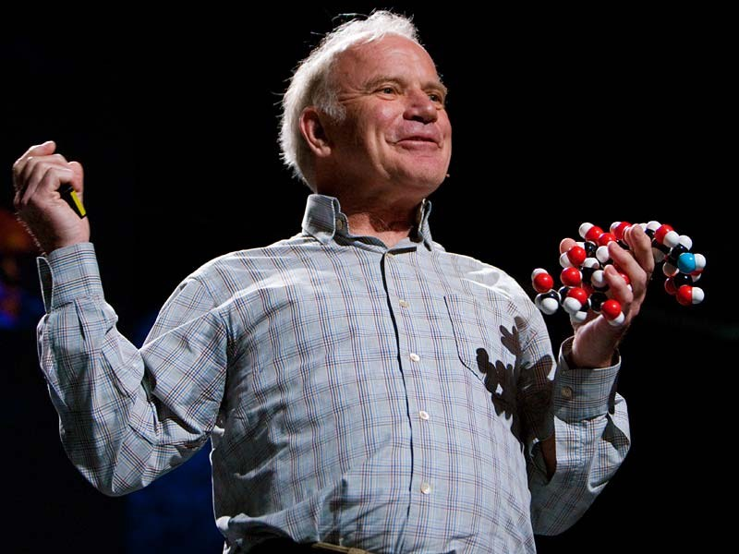
What is PCR?
PCR is an exponentially progressing synthesis of the defined target DNA sequences in vitro.
It was invented in 1983 by Dr. Kary Mullis
Nobel Prize in 1993
Notes:
Polymerase chain reaction (PCR) is a common laboratory technique used to make many copies (millions or billions!) of a particular region of DNA. This DNA region can be anything the experimenter is interested in. For example, it might be a gene whose function a researcher wants to understand, or a genetic marker used by forensic scientists to match crime scene DNA with suspects.
The goal of PCR is to make enough of the target DNA region that it can be analyzed or used in some other way.

Slide 24
Polymerase Chain Reaction (PCR) Why “Polymerase” ?
It is called “polymerase” because the only enzyme used in this reaction is DNA polymerase.
Why “Chain” ?
It is called “chain” because the products of the first reaction become substrates of the following one, and so on.

Slide 25
The “Reaction” Components
Polymerase Chain Reaction (PCR)
1) Target DNA - contains the sequence to be amplified.
2) Pair of Primers - oligonucleotides that define the sequence to be amplified.
3) dNTPs - deoxynucleotidetriphosphates: DNA building blocks.
4) Thermostable DNA Polymerase - enzyme that catalyzes the reaction
5) Mg⁺⁺ ions - cofactor of the enzyme
6) Buffer solution - maintains pH and ionic strength of the reaction solution suitable for the activity of the enzyme
Notes:
Taq polymerase
Like DNA replication in an organism, PCR requires a DNA polymerase enzyme that makes new strands of DNA, using existing strands as templates. The DNA polymerase typically used in PCR is called Taq polymerase, after the heat-tolerant bacterium from which it was isolated (Thermus aquaticus).
Taq polymerase is very heat-stable and is most active around 70C (a temperature at which a human or E. coli DNA polymerase would be nonfunctional). This heat-stability makes Taq polymerase ideal for PCR. High temperature is used repeatedly in PCR to denature the template DNA, or separate its strands.
PCR primers
Like other DNA polymerases, Taq polymerase can only make DNA if it's given a primer, a short sequence of nucleotides that provides a starting point for DNA synthesis. In a PCR reaction, the experimenter determines the region of DNA that will be copied, or amplified, by the primers she or he chooses.
PCR primers are short pieces of single-stranded DNA, usually around 20-22 nucleotides in length. Two primers are used in each PCR reaction, and they are designed so that they flank the target region (region that should be copied). That is, they are given sequences that will make them bind to opposite strands of the template DNA, just at the edges of the region to be copied. The primers bind to the template by complementary base pairing.
When the primers are bound to the template, they can be extended by the polymerase, and the region that lies between them will get copied.

Slide 26
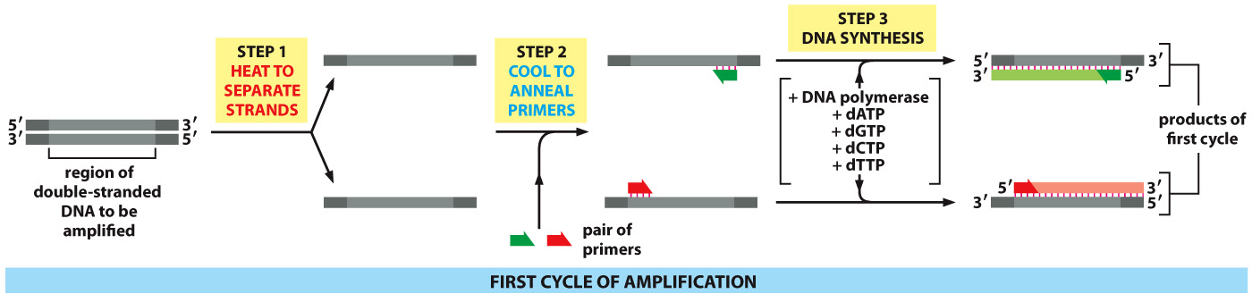
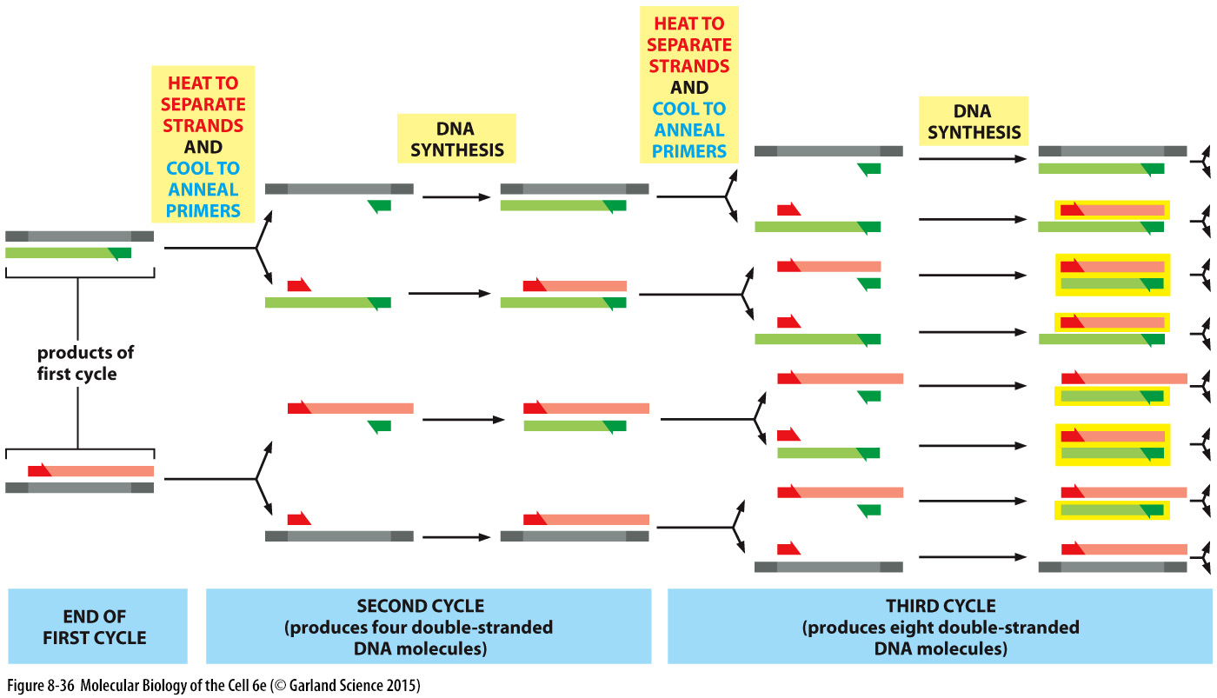
Notes:
The steps of PCR
The key ingredients of a PCR reaction are Taq polymerase, primers, template DNA, and nucleotides (DNA building blocks). The ingredients are assembled in a tube, along with cofactors needed by the enzyme, and are put through repeated cycles of heating and cooling that allow DNA to be synthesized.
The basic steps are:
Denaturation (96 C): Heat the reaction strongly to separate, or denature, the DNA strands. This provides single-stranded template for the next step.
Annealing (55C): Cool the reaction so the primers can bind to their complementary sequences on the single-stranded template DNA.
Extension (72C): Raise the reaction temperatures so Taq polymerase extends the primers, synthesizing new strands of DNA.
This cycle repeats 25- 35 times in a typical PCR reaction, which generally takes 2 - 4 hours, depending on the length of the DNA region being copied.
That’s because it’s not just the original DNA that’s used as a template each time. Instead, the new DNA that’s made in one round can serve as a template in the next round of DNA synthesis. There are many copies of the primers and many molecules of Taq polymerase floating around in the reaction, so the number of DNA molecules can roughly double in each round of cycling.

Slide 27
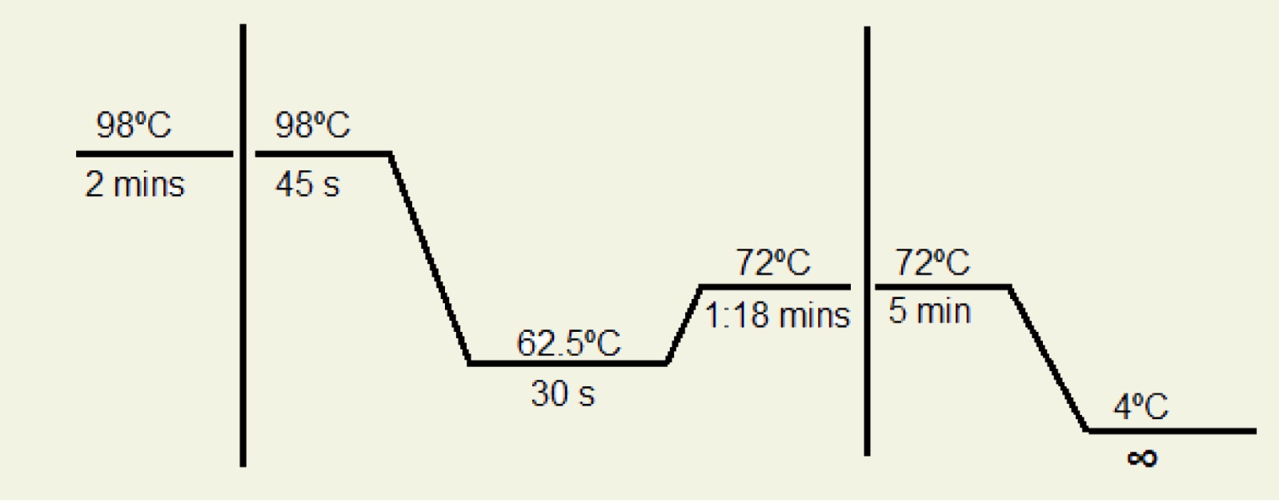
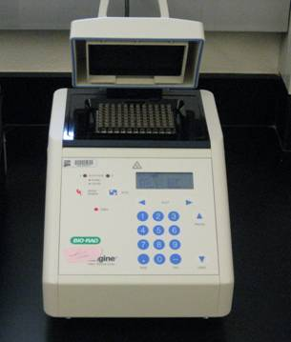
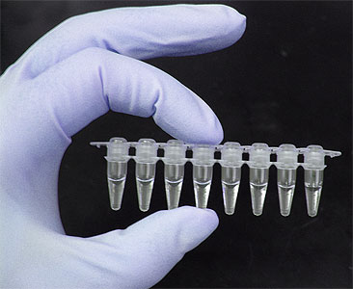
Reaction Cycle and the Machine
Cycle-1
Cycle-2 (x 20-35)
Cycle-3
Temperature
Time
30 cycles = 2³⁰ i.e. 1,073,741,824 copies
PCR tube
Thermocycler

Slide 28
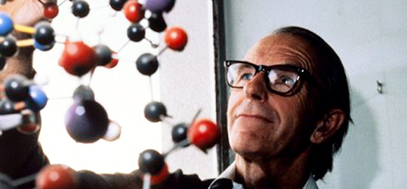
DNA Sequencing
Frederick Sanger
Nobel Prize in 1980
Sequencing: The process by which you determine the exact order of the nucleotides in a given region of DNA
Why? To decode the genetic information embedded in DNA
How? Through complementary chain synthesis and early termination
The synthesized chains are visualized by methods using:
Radioactive labels
Nonradioactive labels
Notes:
Definition:
“A laboratory technique employed to known the correct DNA sequence by the sequential chemical reaction is known as DNA sequencing.”
laboratory processing and computational analysis both are the key processes in DNA sequencing. Once the chemical reaction is completed, the machine-generated data are sent to the computer lab.
In the process, the amplification done by each nucleotide is recorded in the form of signals which are collected by the machine and analyzed on the computer. This is the basic mechanism, the nucleotides are either radio or fluorescent-labeled.

Slide 29
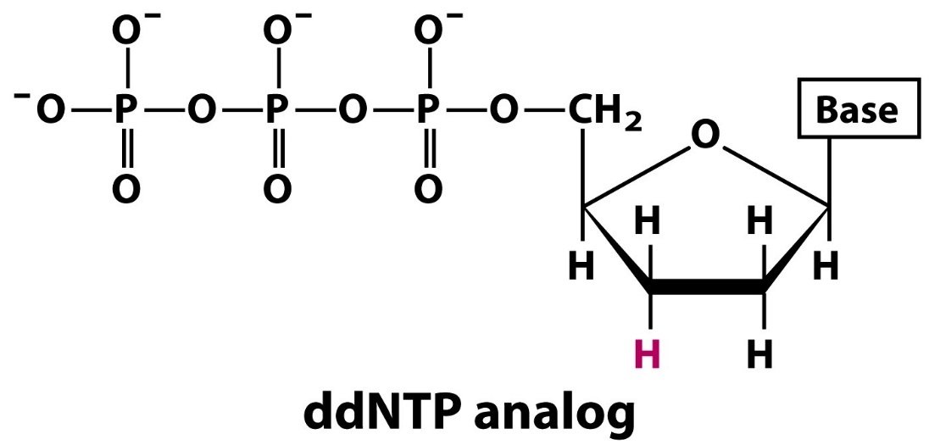
Dideoxynucleotides (ddNTPs)
OH
dNTP
The 3’ hydroxyl has been changed to a hydrogen in ddNTP’s, which terminates a DNA chain because a phosphodiester bond cannot form at this 3’ location
Notes:
Now let us understand the process stepwise. But before we do so let us briefly mention about one of the critical components that is ddNTPs. The 3’ hydroxyl has been changed to a hydrogen in ddNTP’s, which terminates a DNA chain because a phosphodiester bond cannot form at this 3’ location.
The Steps that mentioned below are the generalized representation of DNA sequencing, it may vary from sequencing platform to platform.
Sample preparation (DNA extraction)
PCR amplification of target sequence
DNA Sequencing
Data analysis
Sample prep:
Here the DNA is isolated first. Animal, plant, bacterial, plasmid, or environmental DNA can be used for it.
PCR amplification of target sequence:
Amplification is the key step in sequencing. Here only the gene of interest or the DNA sequence we wish to study is first amplified, the rest of the DNA is discarded.
DNA sequencing:
The prepared reaction tubes are placed into the sequencer machine. During, the reaction in the sequencer, denaturation, annealing, and extension occurs, simultaneously.
Data analysis:
Once the whole DNA is sequenced, the result is saved into one unique file format. The inbuilt software (provided by the manufacturer) processed the data and compared it with the available data.

Slide 30
Requirements for Sanger-Coulson Sequencing
DNA to be sequenced must be in single strand form
The region to be sequenced must be flanked by a stretch of 3’ known sequence
Reagents needed are:
A primer complementary to the known region to direct chain synthesis.
DNA polymerase.
4 deoxynucleotide triphosphates (dNTPs).
4 dideoxynucleotide triphosphates (ddNTPs)
(one for each set)

Slide 31

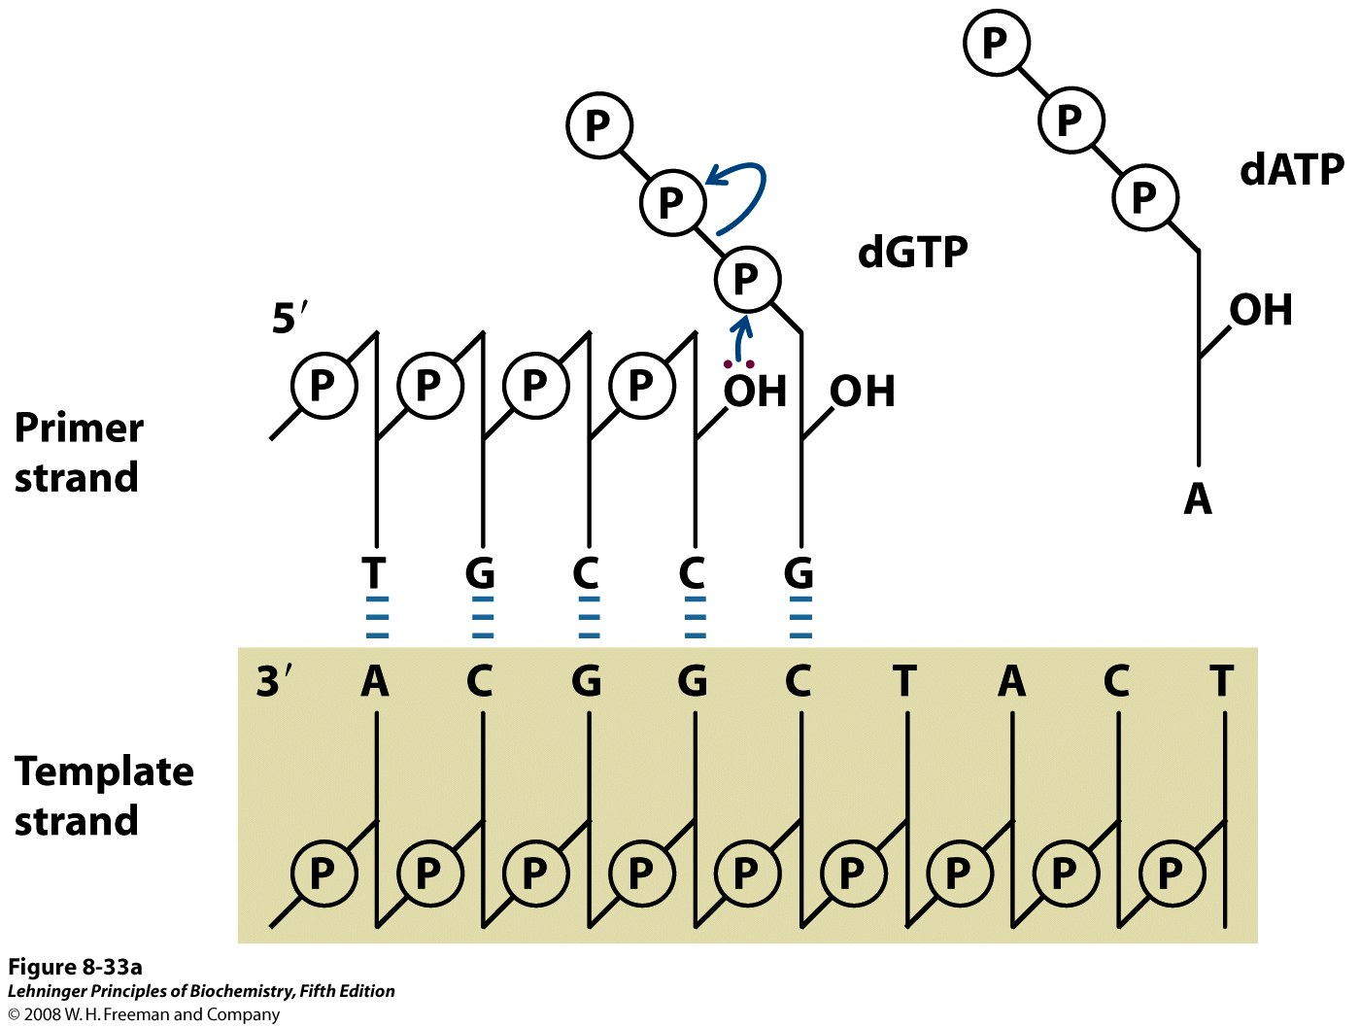
Mechanism of DNA polymerization
Since the 3’ –OH is changed to a –H in ddNTPs, it is unable to form a phosphodiester bond by nucleophilic attack on the phosphate, and it will cause a termination in the DNA chain

Slide 32
Sequencing using denaturing gel-electrophoresis
Primer
Template
3’ – A T A T C T G T A C C T A G G T G A G T C A G T A C C -5’
5’ – T A T A G A C
5’ – T A T A G A C A
5’ – T A T A G A C A T G G A
5’ – T A T A G A C A T G G A T C C A
5’ – T A T A G A C A T G G A T C C A C T C A
5’ – T A T A G A C A T G G A T C C A C T C A G T C A
Differentially elongated fragments
To each reaction along with the four regular dNTPs, only one of the four dideoxynucleotides (ddATP in the above reaction) are added
The ddNTP is added to be approximately 100-fold lower in concentration than the corresponding dNTP
A series of differentially elongated DNA fragments (hence of different length) will be produced
Can be visualized by labelling the primers with radioactive phosphate (³²P or ³³P)
Notes:
Primers are labelled radioactively.
Write the primer (complementary to the template), think of the situations where you would encounter any one of the ddNTPs. Where will the reactions stop?

Slide 33
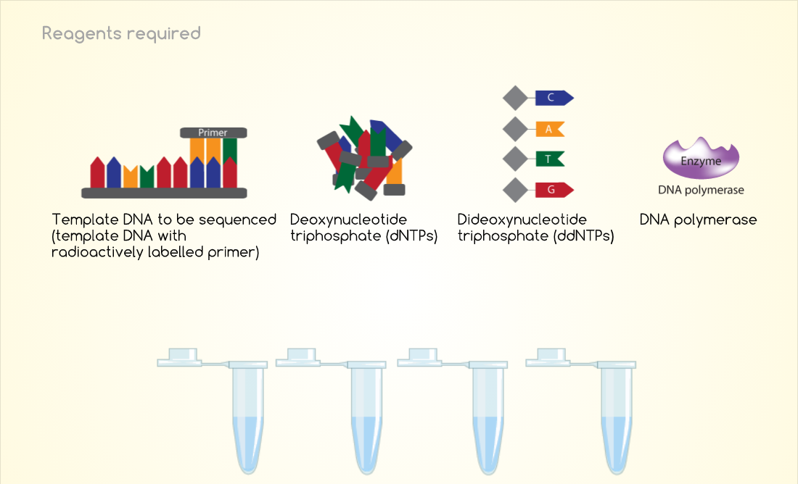
Reaction mixtures

Slide 34
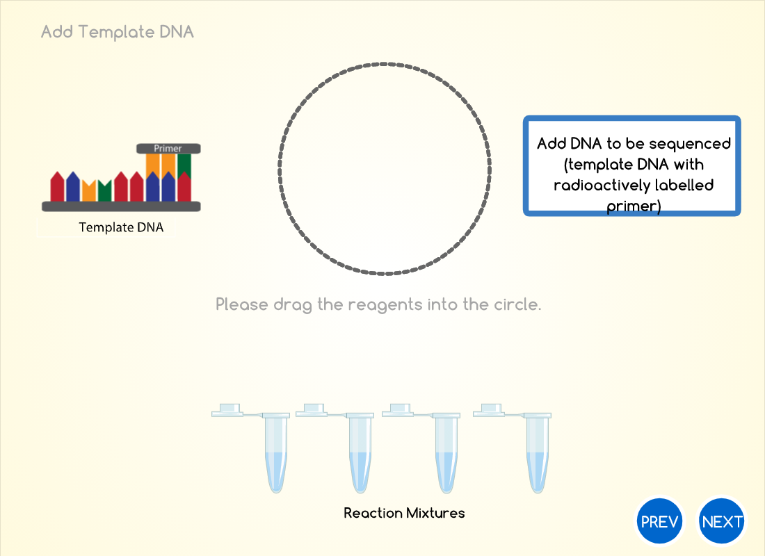
Reaction mixtures

Slide 35
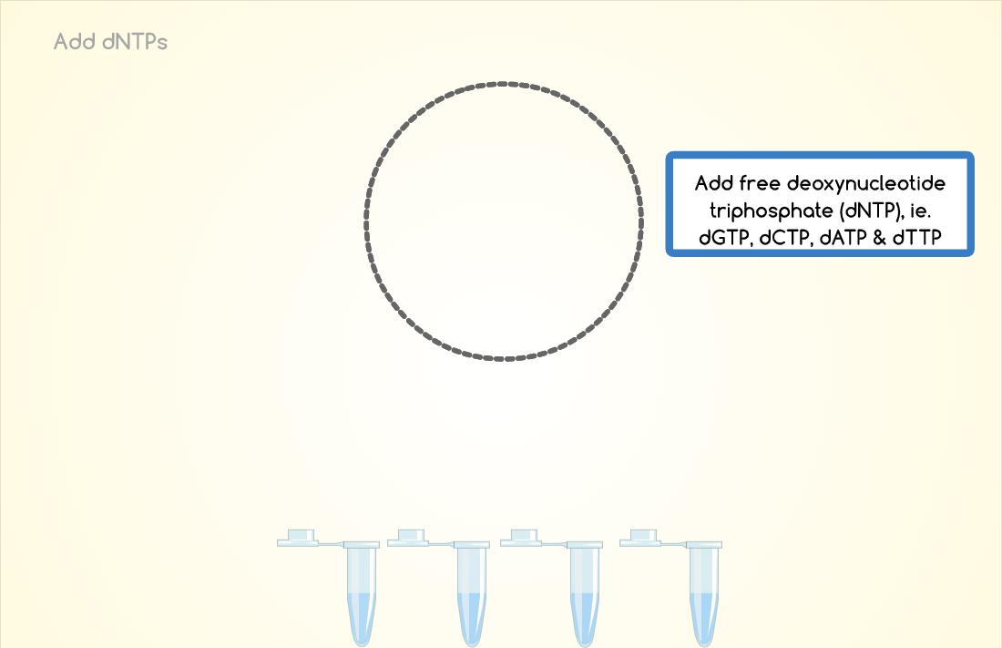
Reaction mixtures

Slide 36
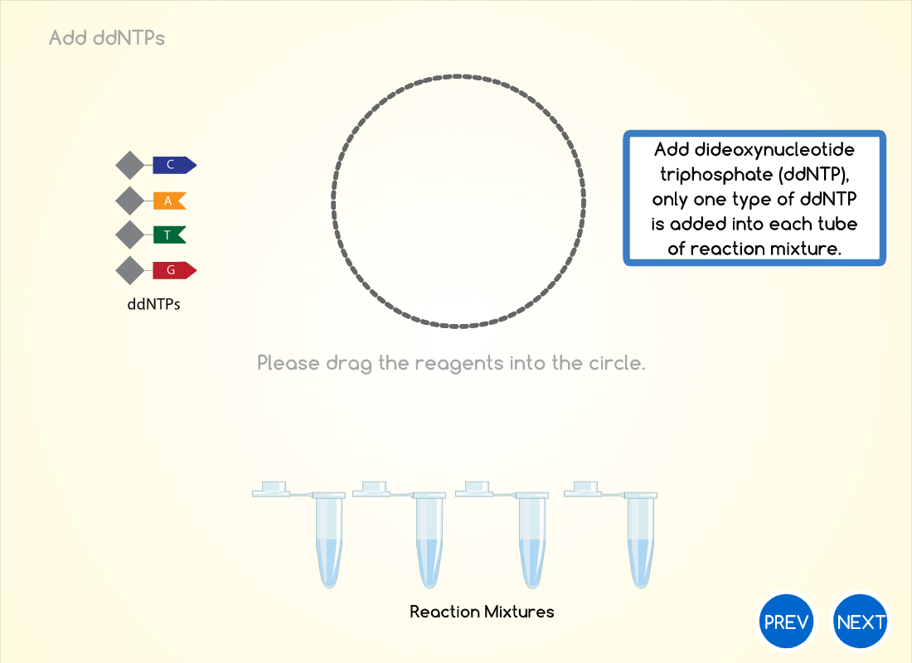
Reaction mixtures

Slide 37
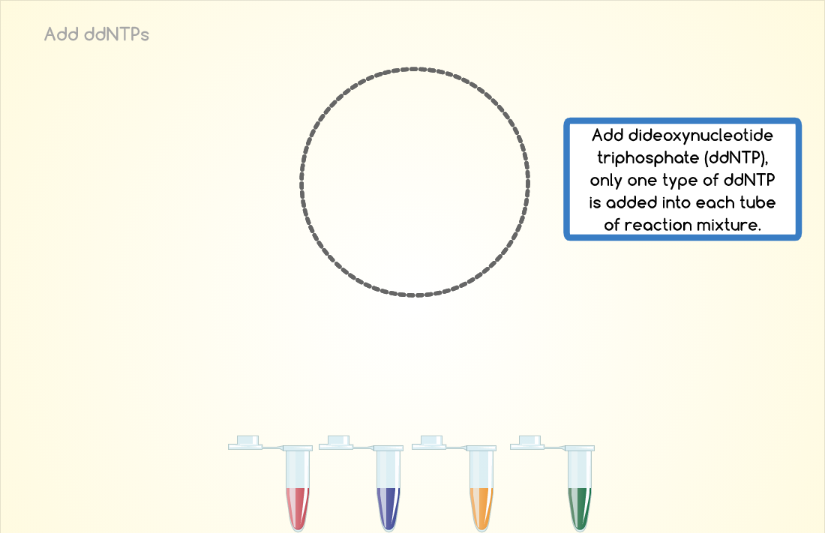
Reaction mixtures

Slide 38
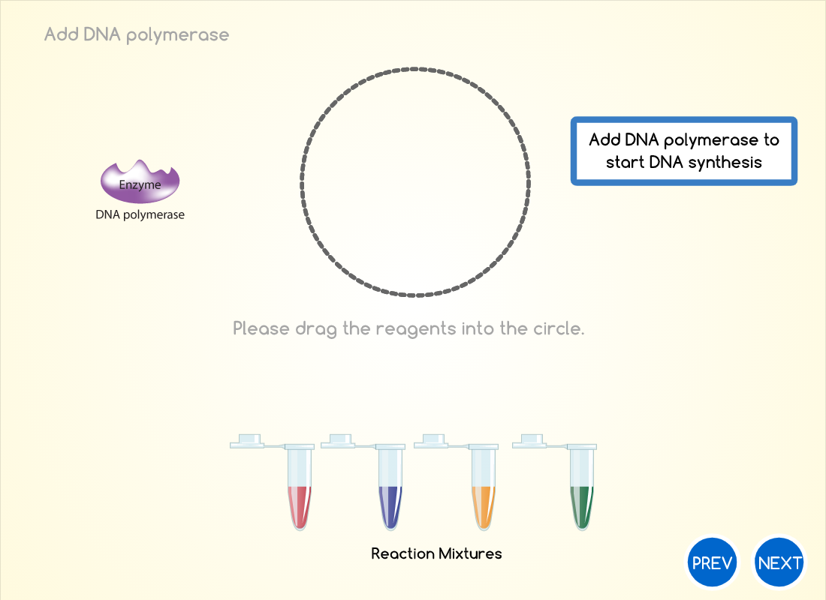
Reaction mixtures

Slide 39
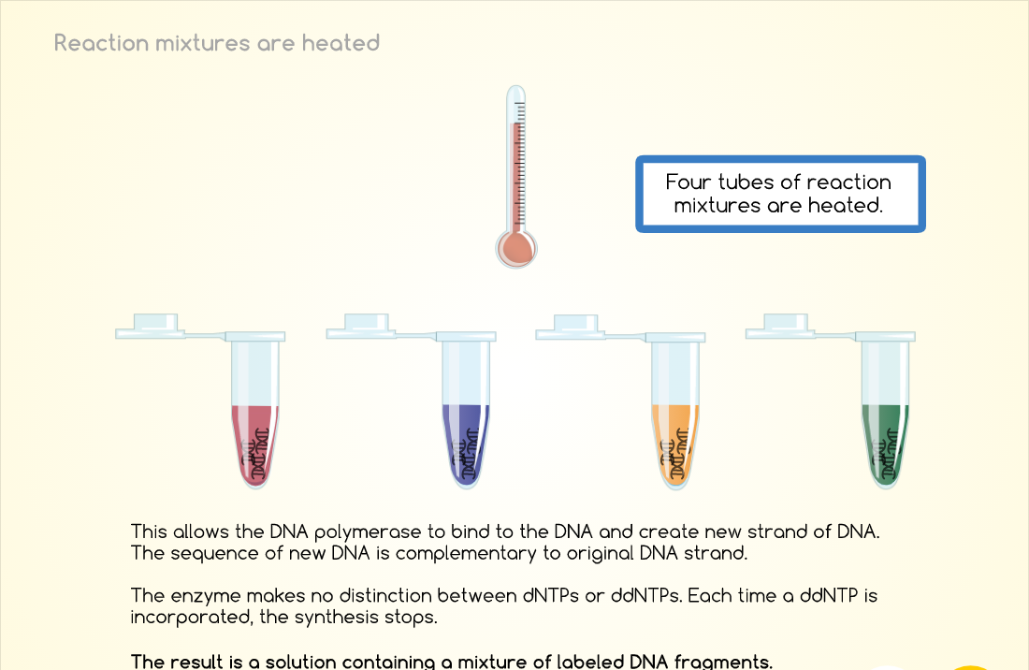

Slide 40
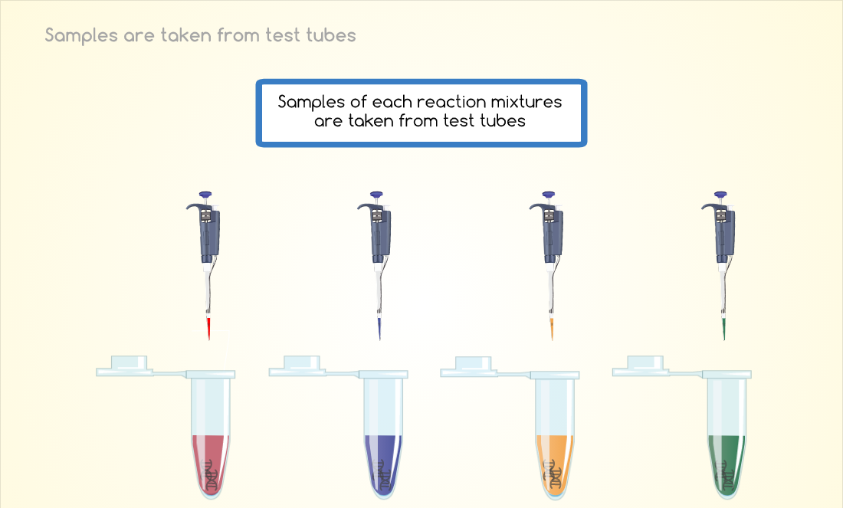

Slide 41
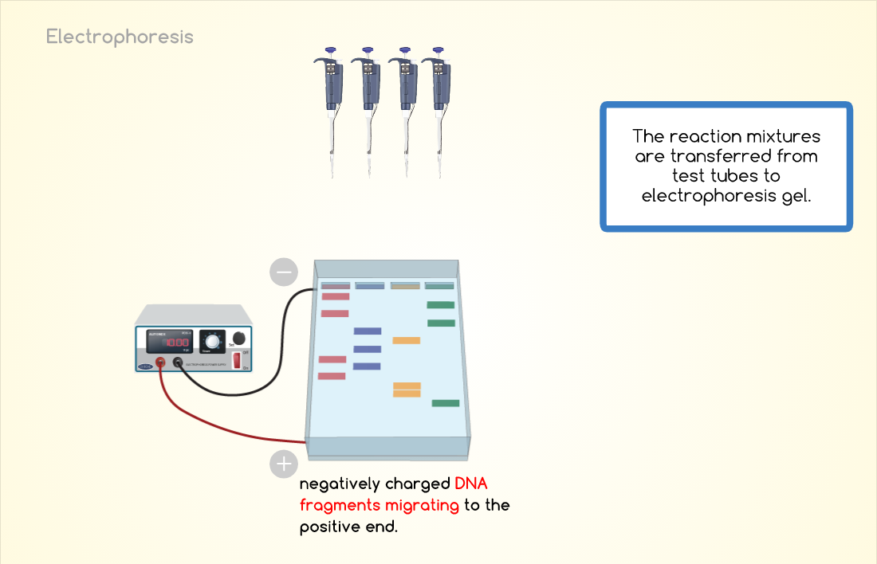

Slide 42
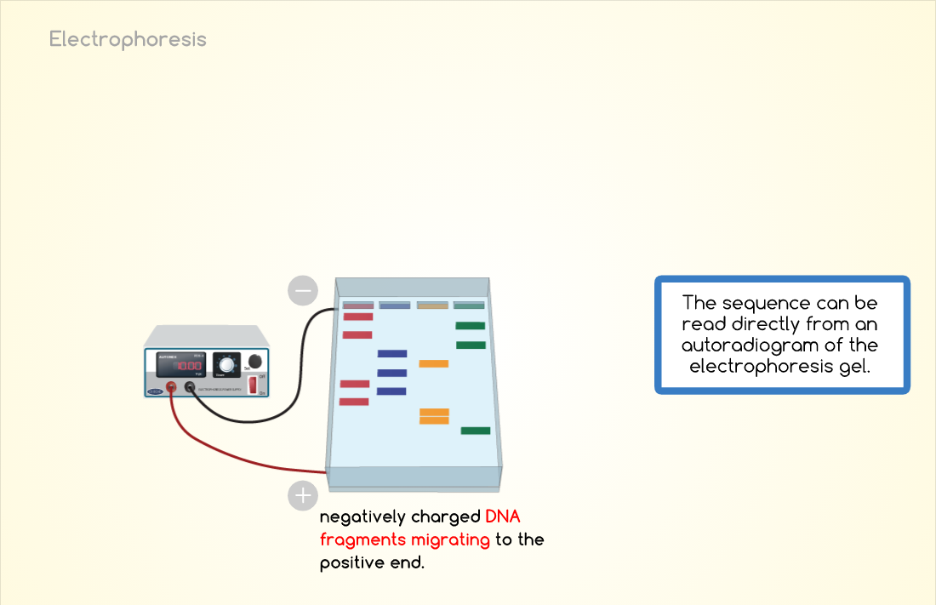

Slide 43
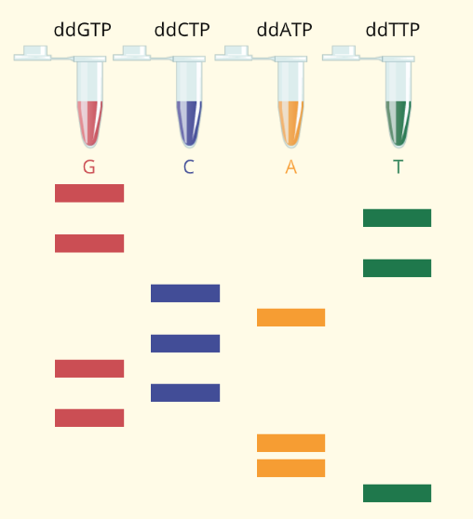
Please write down the sequence of the DNA synthesized here
Notes:
Shorter DNA fragments migrate faster, the fragments near the bottom of the gel represent the nucleotide positions closest to the primer (the 5’end), and the sequence is read (in the 5’ to 3’ direction) from bottom to top.
The sequence of template DNA is the strand complementary to the strand being synthesized

Slide 44
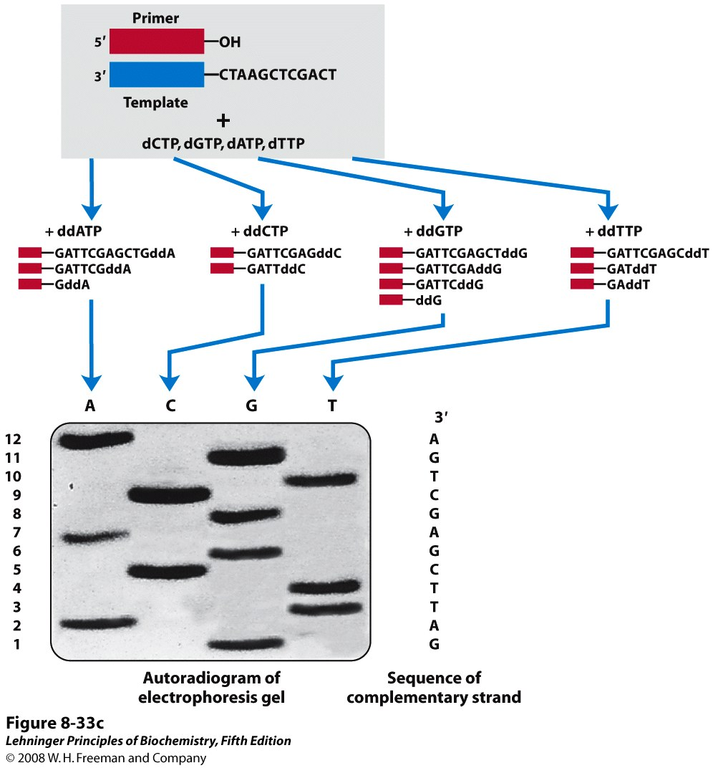
Sequencing using denaturing gel-electrophoresis
Notes:
FIGURE 8-33c DNA sequencing by the Sanger method. This method makes use of the mechanism of DNA synthesis by DNA polymerases (Chapter 25). (c) The DNA to be sequenced is used as the template strand, and a short primer, radioactively or fluorescently labeled, is annealed to it. By addition of small amounts of a single ddNTP, for example ddCTP, to an otherwise normal reaction system, the synthesized strands will be prematurely terminated at some locations where dC normally occurs. Given the excess of dCTP over ddCTP, the chance that the analog will be incorporated whenever a dC is to be added is small. However, ddCTP is present in sufficient amounts to ensure that each new strand has a high probability of acquiring at least one ddC at some point during synthesis. The result is a solution containing a mixture of labeled fragments, each ending with a C residue. Each C residue in the sequence generates a set of fragments of a particular length, such that the different-sized fragments, separated by electrophoresis, reveal the location of C residues. This procedure is repeated separately for each of the four ddNTPs, and the sequence can be read directly from an autoradiogram of the gel. Because shorter DNA fragments migrate faster, the fragments near the bottom of the gel represent the nucleotide positions closest to the primer (the 5′ end), and the sequence is read (in the 5′→3′ direction) from bottom to top. Note that the sequence obtained is that of the strand complementary to the strand being analyzed.

Slide 45
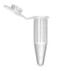
G
A
T
T
C
G
A
G
C
T
G
A
+ddCTP
+ddGTP
+ddATP
+ddTTP
GATTddC
5
ddG
1
GddA
2
GAddT
3
GATTCGAGddC
9
GATTCddG
6
GATTCGddA
7
GATddT
4
GATTCGAddG
8
GATTCGAGCTGddA
12
GATTCGAGCddT
GATTCGAGCTddG
11
10

Slide 46
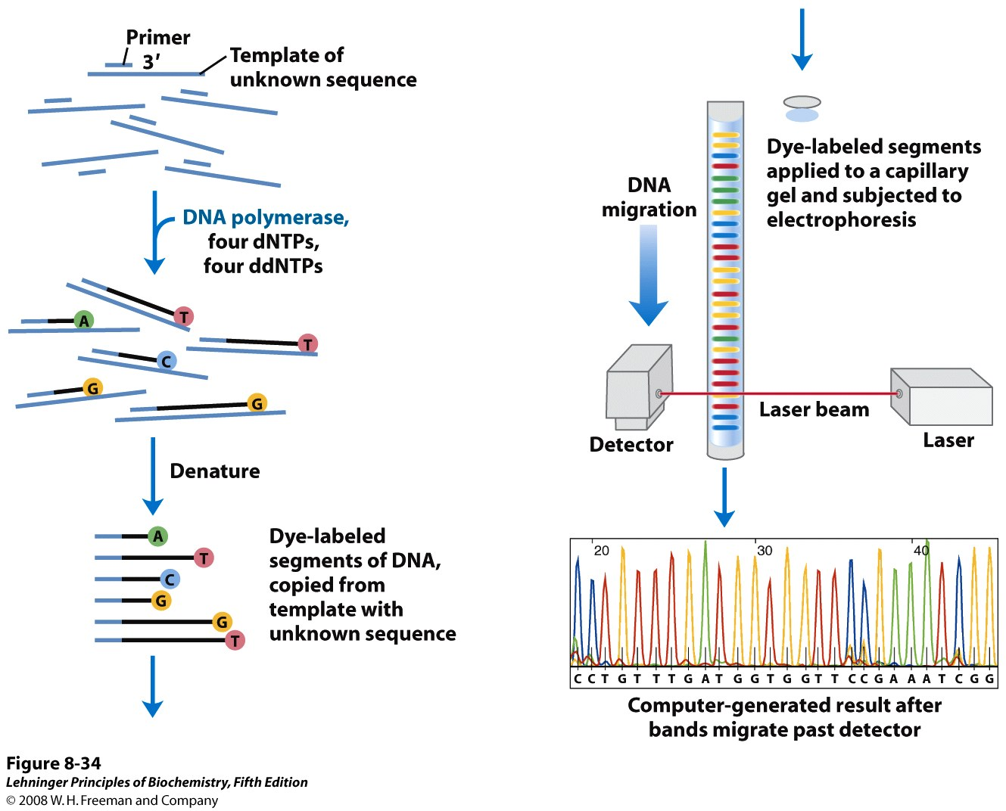
Automated sequencing
Notes:
FIGURE 8-34 Strategy for automating DNA sequencing reactions. Each dideoxynucleotide used in the Sanger method can be linked to a fluorescent molecule that gives all the fragments terminating in that nucleotide a particular color. All four labeled ddNTPs are added to a single tube. The resulting colored DNA fragments are then separated by size in a single electrophoretic gel contained in a capillary tube (a refinement of gel electrophoresis that allows for faster separations). All fragments of a given length migrate through the capillary gel in a single peak, and the color associated with each peak is detected using a laser beam. The DNA sequence is read by determining the sequence of colors in the peaks as they pass the detector. This information is fed directly to a computer, which determines the sequence.

Slide 47
Automated sequencing
Each dideoxynucleotide used are linked to a fluorescent molecule that gives all the fragments terminating in that nucleotide a particular color.
All four labelled ddNTPs are added to a single tube.
The resulting colored DNA fragments are then separated by capillary gel electrophoresis
The color associated with each peak is detected using a laser beam.
The DNA sequence is read by determining the sequence of colors in the peaks as they pass the detector.
This information is fed directly to a computer, which determines the sequence.

Slide 48
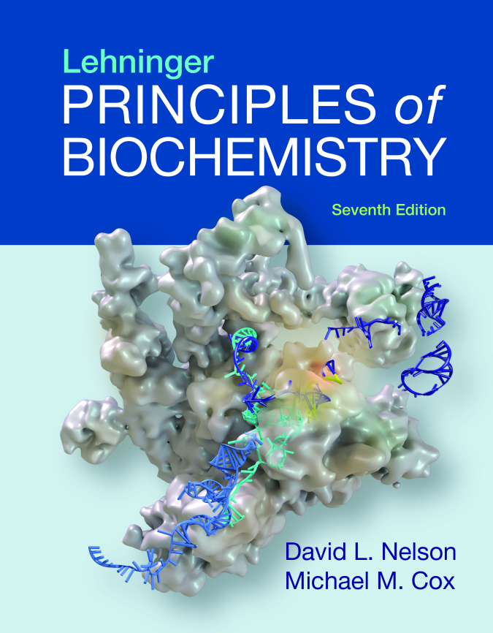
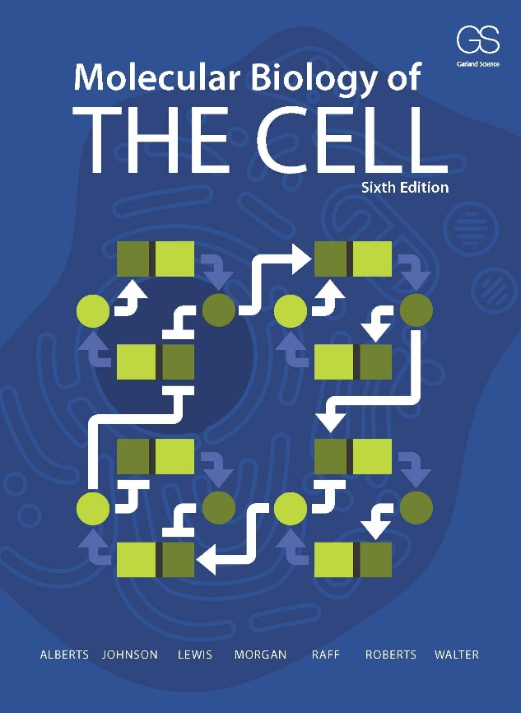
References

Slide 49
Extra resources
Book:
The Double Helix: A Personal Account of the Discovery of the Structure of DNA - By James D Watson
Videos:
DNA replication
https://www.youtube.com/watch?v=TNKWgcFPHqw
DNA sequencing:
https://www.youtube.com/watch?v=vK-HlMaitnE
https://www.youtube.com/watch?v=-QIMkQ4E_wE&t=487s
Polymerase Chain Reaction (PCR)
http://video.mit.edu/watch/pcr-polymerase-chain-reaction-10948/
https://www.dnalc.org/view/15475-The-cycles-of-the-polymerase-chain-reaction-PCR-3D-animation.html

